Slide 1



TOOLKIT
CASCADE TRAINING
Project Proposal writing
SOUPHANOUVONG UNIVERSITY
1st December 2021
By: Palitha DOUAGCHACK
E-mail: palitha_su@yahoo.com
SOUPHANOUVONG UNIVERSITY

Slide 2
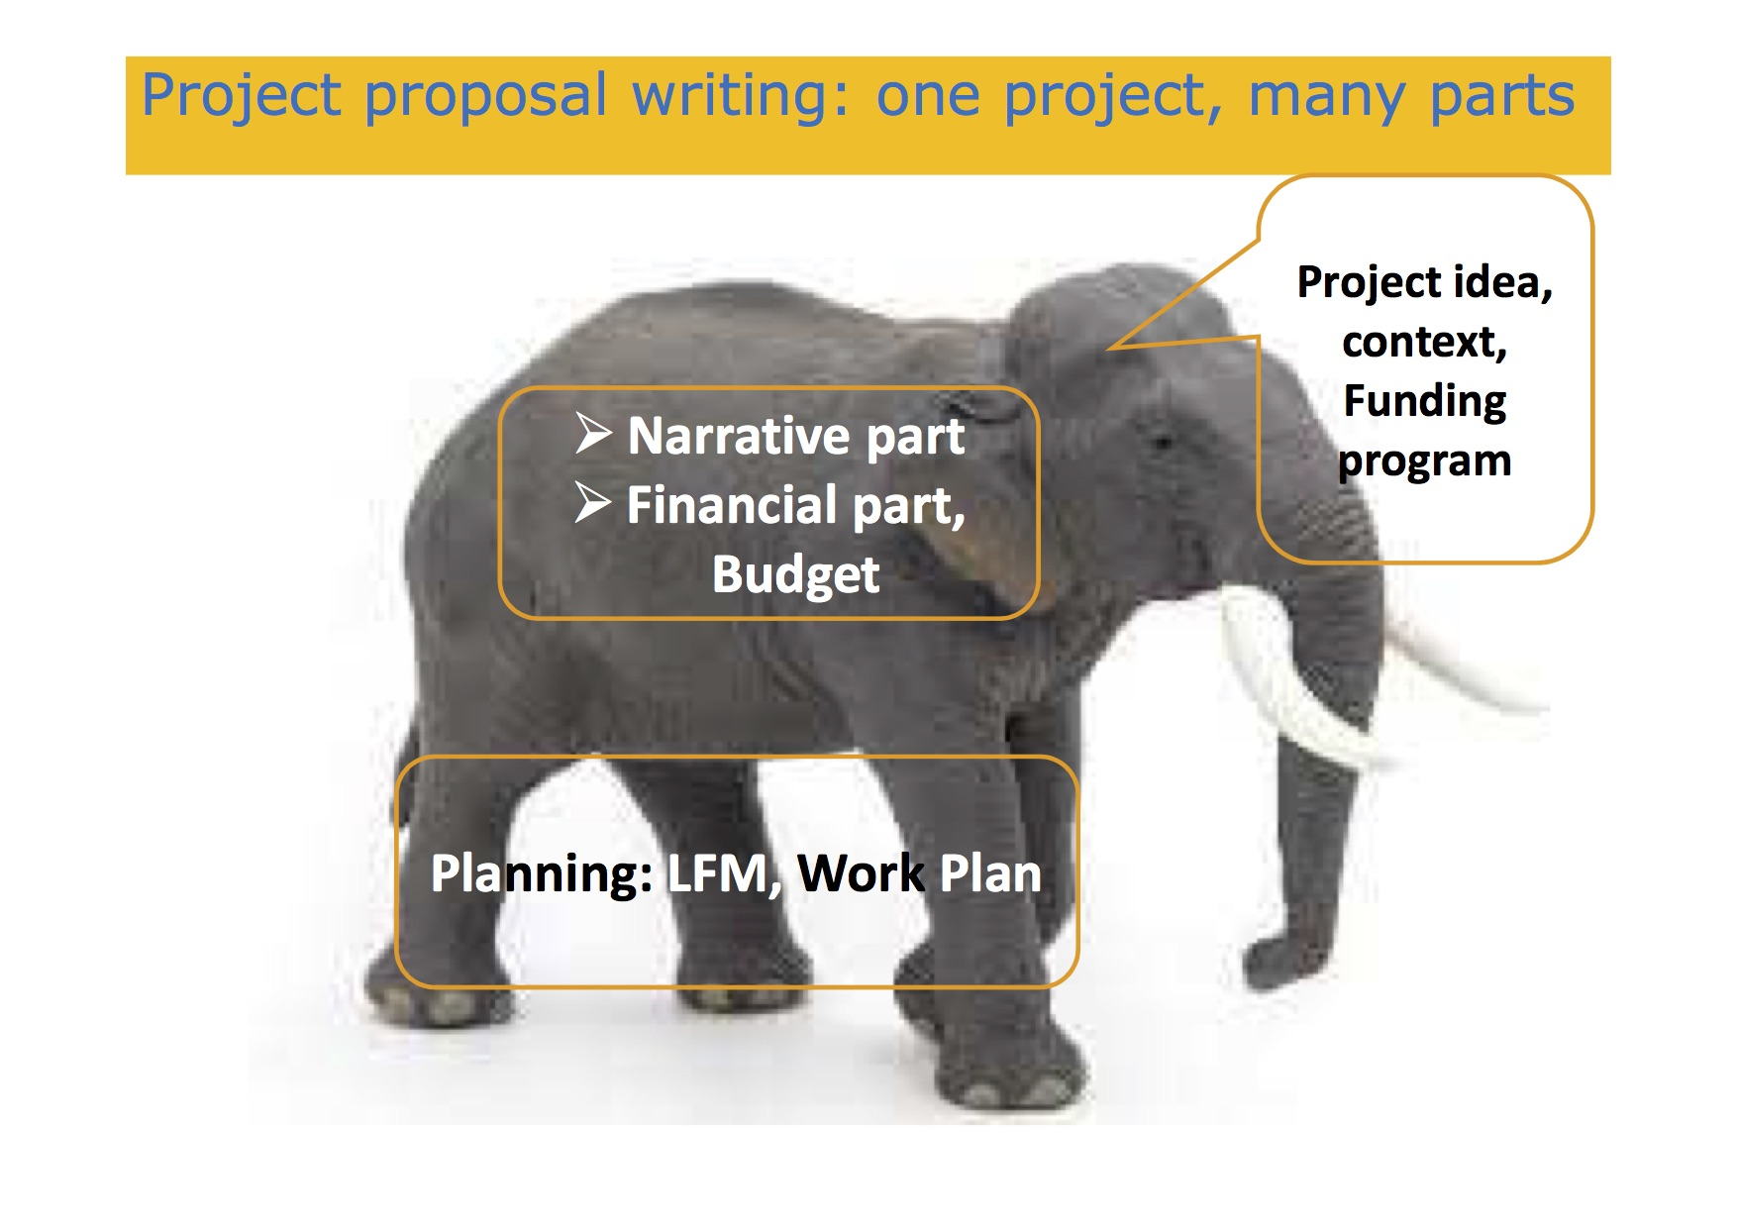

Types of calls and financial opportunities
The main features and documents of a call for proposal
The structure of a guide for applicant
SOUPHANOUVONG UNIVERSITY
SOUPHANOUVONG UNIVERSITY

Slide 3
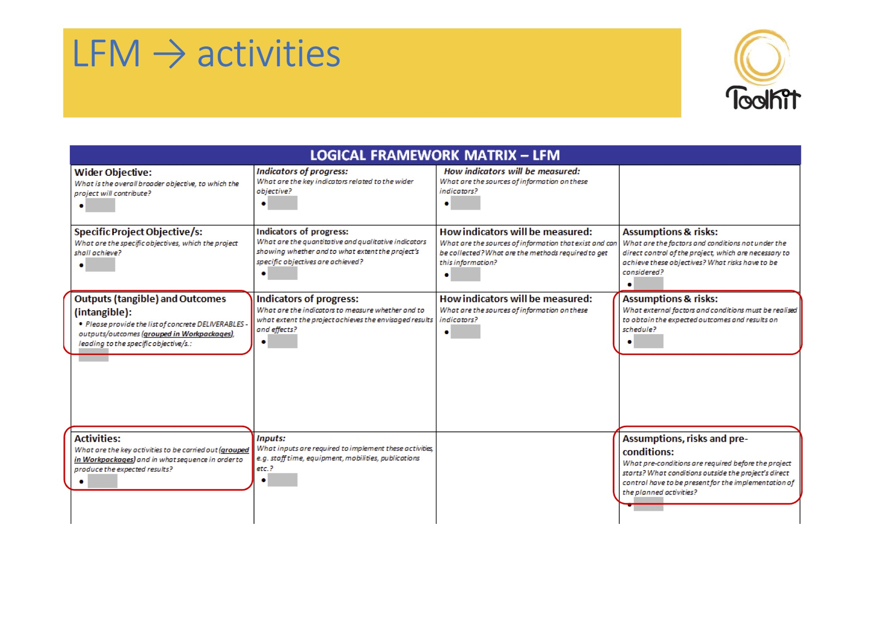
Types of Call And Opportunities
Call for proposal
Call for individual scholarship and fellowship
Call for tenders
Technical cooperation schemes
SOUPHANOUVONG UNIVERSITY
Notes:
Call for proposal:
Proposals describe planned activities, information on who will carry them out and how much they will cost.
Proposal must be relevant to policy background and general objectives defined by the call, but the applicant can be free to propose and develop its own idea

Slide 4
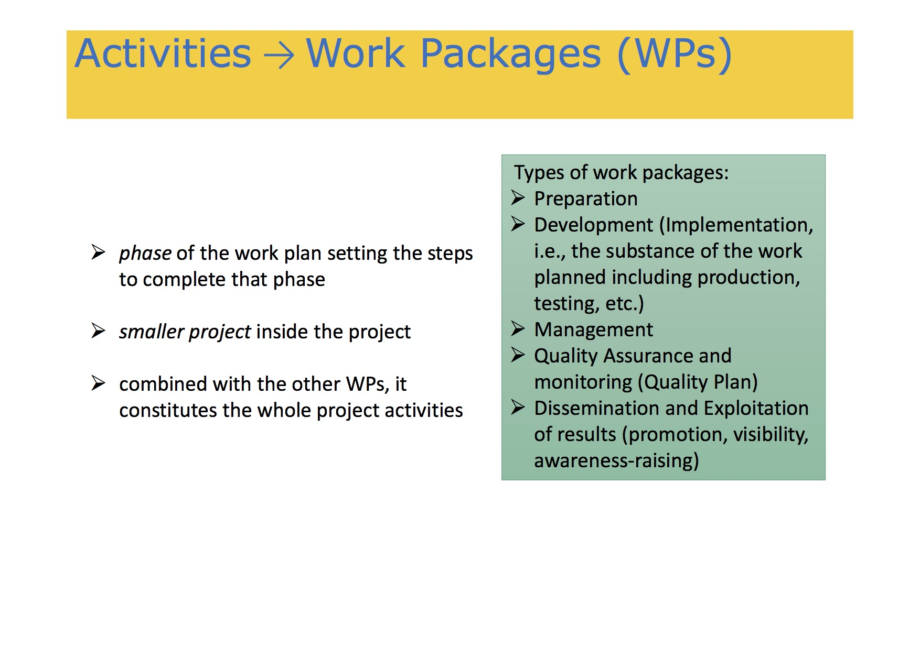
Main documents of a call
Documents concerning a call for proposals:
Work Programme/Guide for Applicants
Application forms and annexes: concept note/full project description, budget, logical framework matrix (may bee filled through online platforms)
Model grant agreement
Other documents
SOUPHANOUVONG UNIVERSITY
SOUPHANOUVONG UNIVERSITY

Slide 5
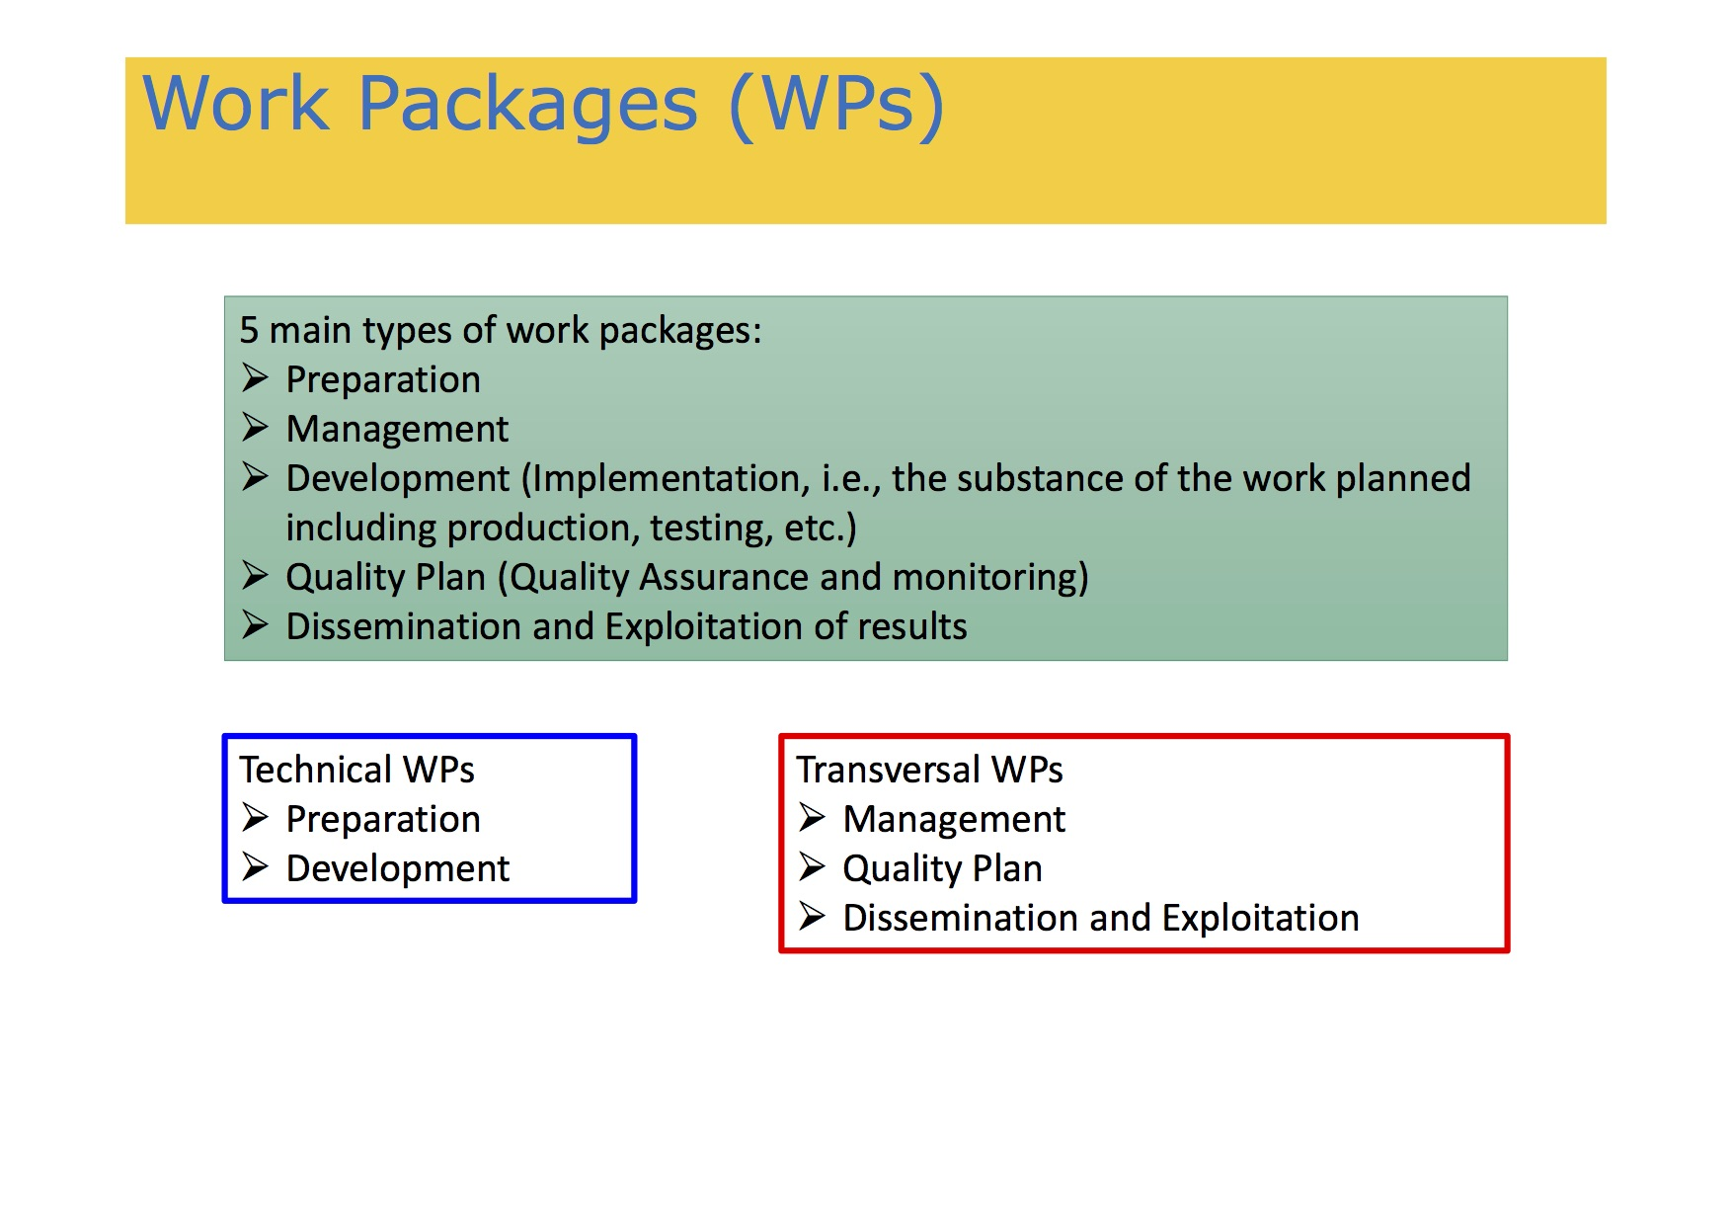
Guide for applicants
Guide for applicants/guidelines/call instructions
Background/policy context
Objectives of the programme
Topics/challenges/priority issues under the call for proposal and expected results
Overall financial allocation for the call and size of the grants (% of co- financing)
Eligibility of applicants
Partnership and eligibility of partners
Eligible actions and eligible costs
Instruction for completing the application form and administrative annexes
Instructions for submission of proposals and procedures to follow
Instructions to fill the budget tables
Deadline and information sources
Check list
Evaluation criteria and selection of applications
SOUPHANOUVONG UNIVERSITY
SOUPHANOUVONG UNIVERSITY

Slide 6
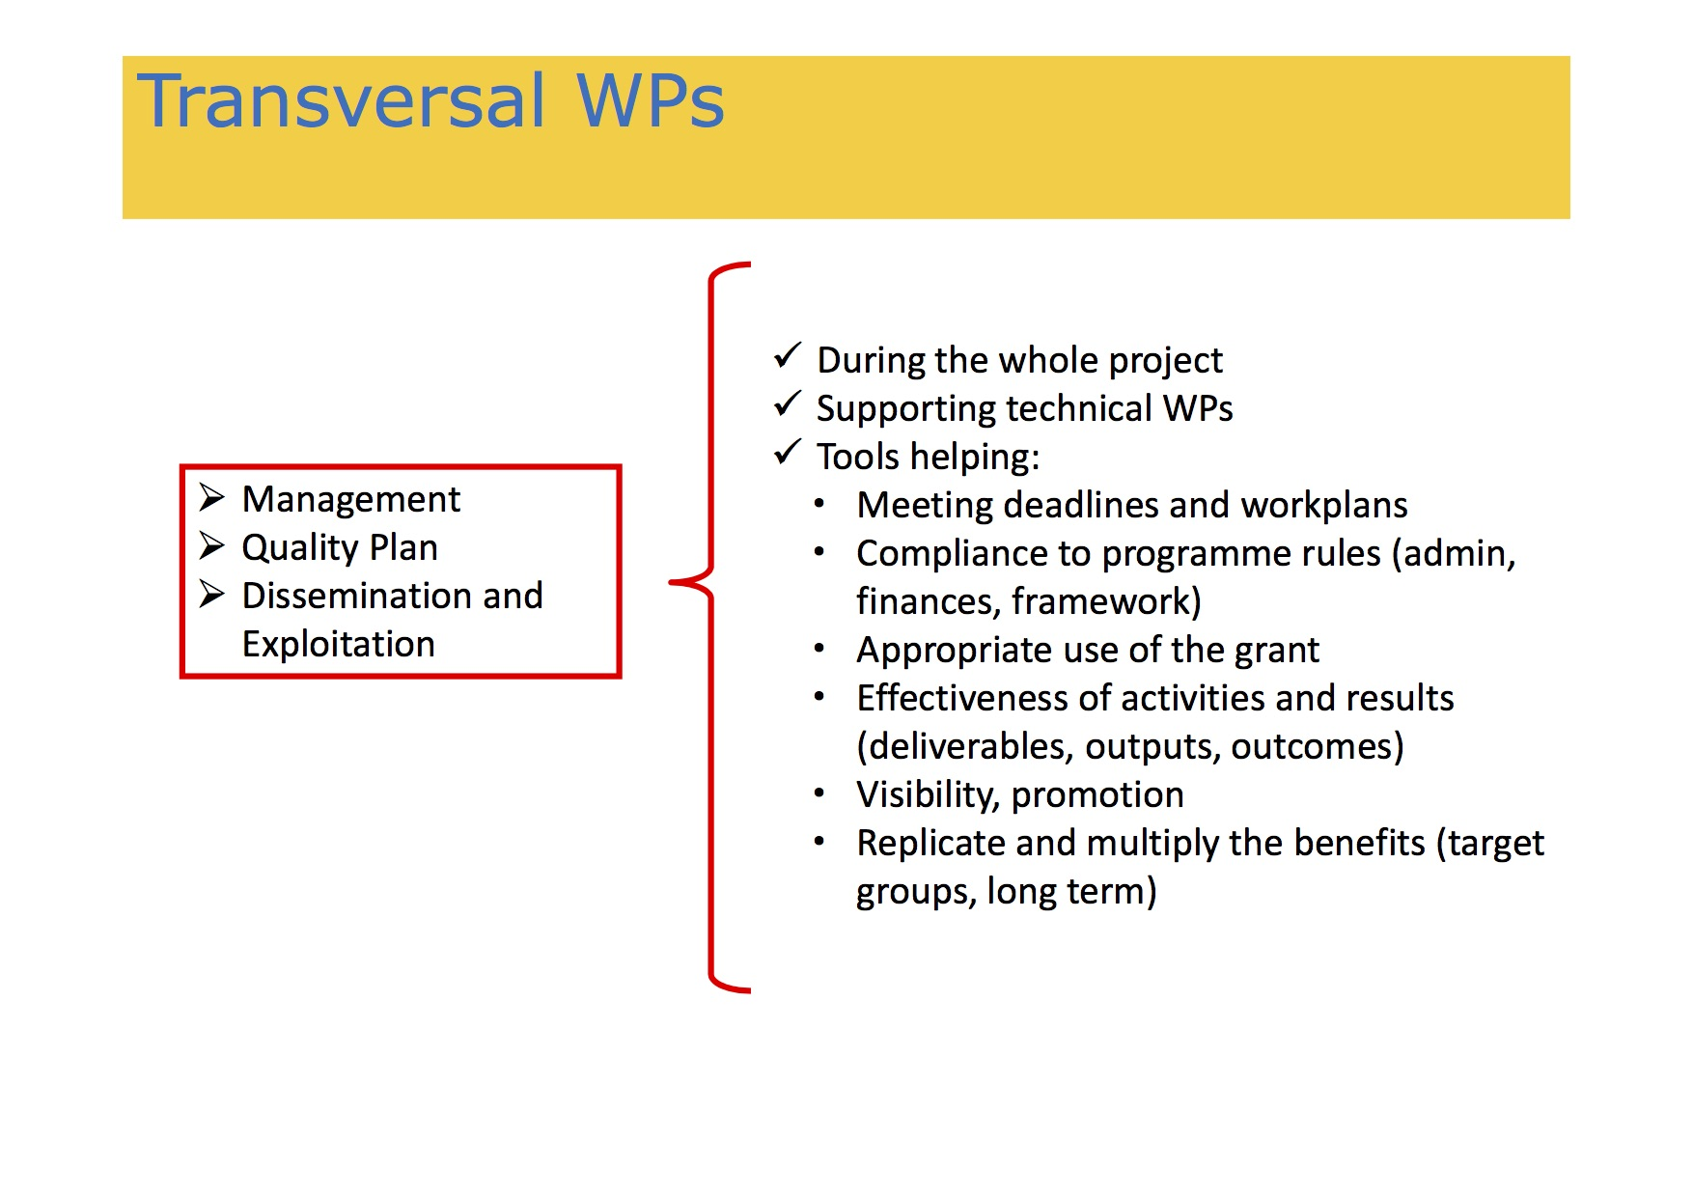
To Summarise
Who is eligible to apply?
Does the call for proposal require a minimum number of participants?
Can I propose my own project idea or do I have to stick to pre- identified thematic priorities?
Does the donor finance my activities at 100% or do I have to co-finance?
What are the award criteria?
Does the call fund conferences, meetings and creation of networks, pay for staff?
What are the eligible categories of costs?
SOUPHANOUVONG UNIVERSITY
SOUPHANOUVONG UNIVERSITY

Slide 7
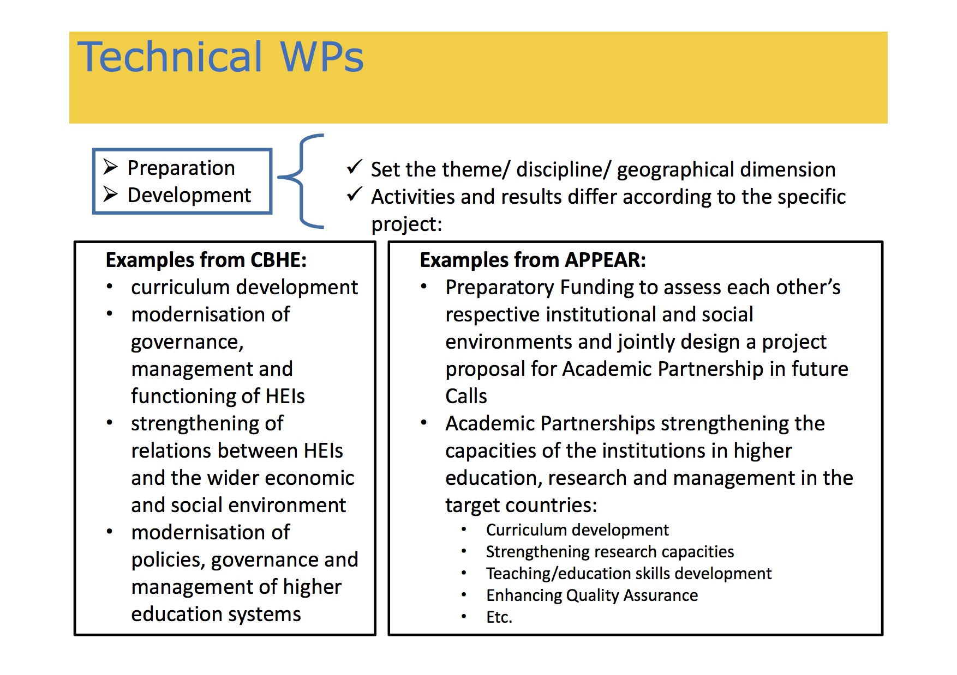
SOUPHANOUVONG UNIVERSITY

Slide 8
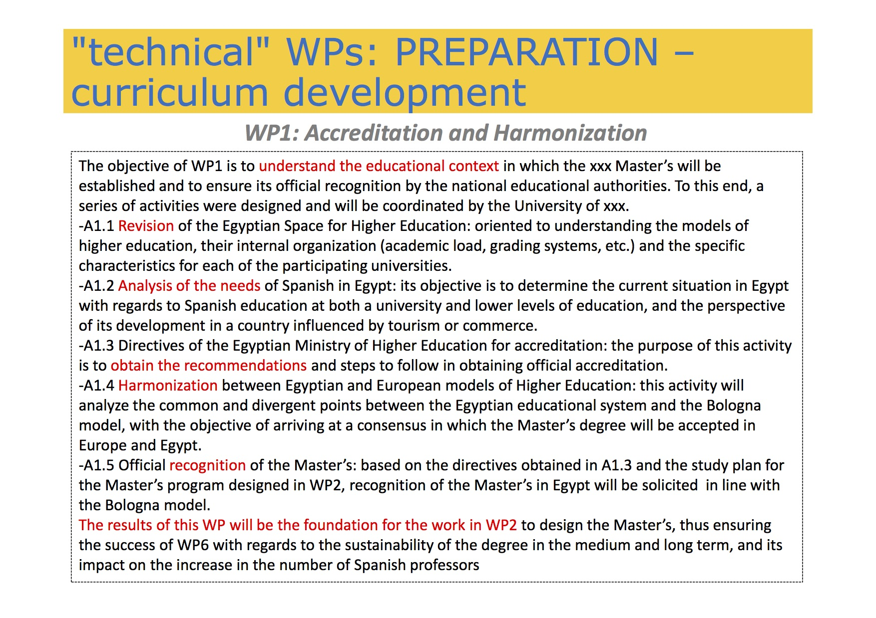
SOUPHANOUVONG UNIVERSITY

Slide 9
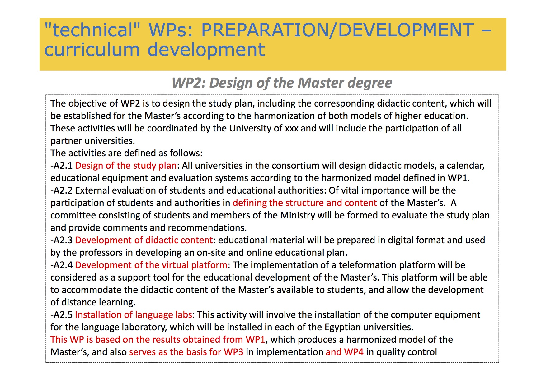
SOUPHANOUVONG UNIVERSITY

Slide 10
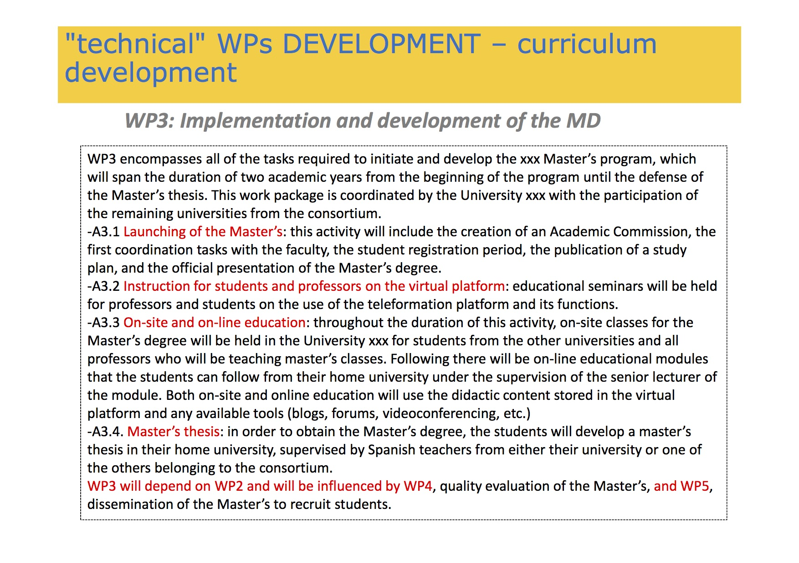
SOUPHANOUVONG UNIVERSITY

Slide 11
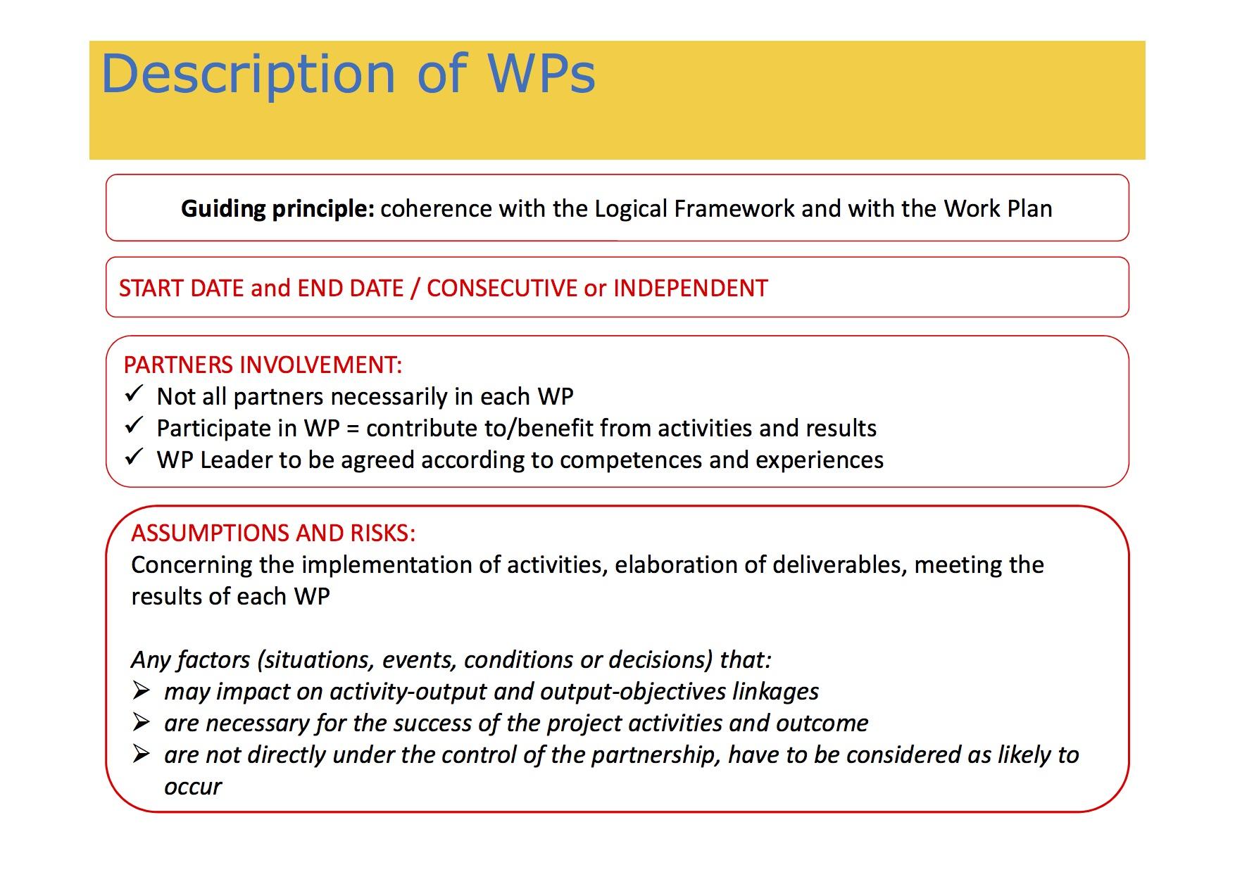
SOUPHANOUVONG UNIVERSITY

Slide 12
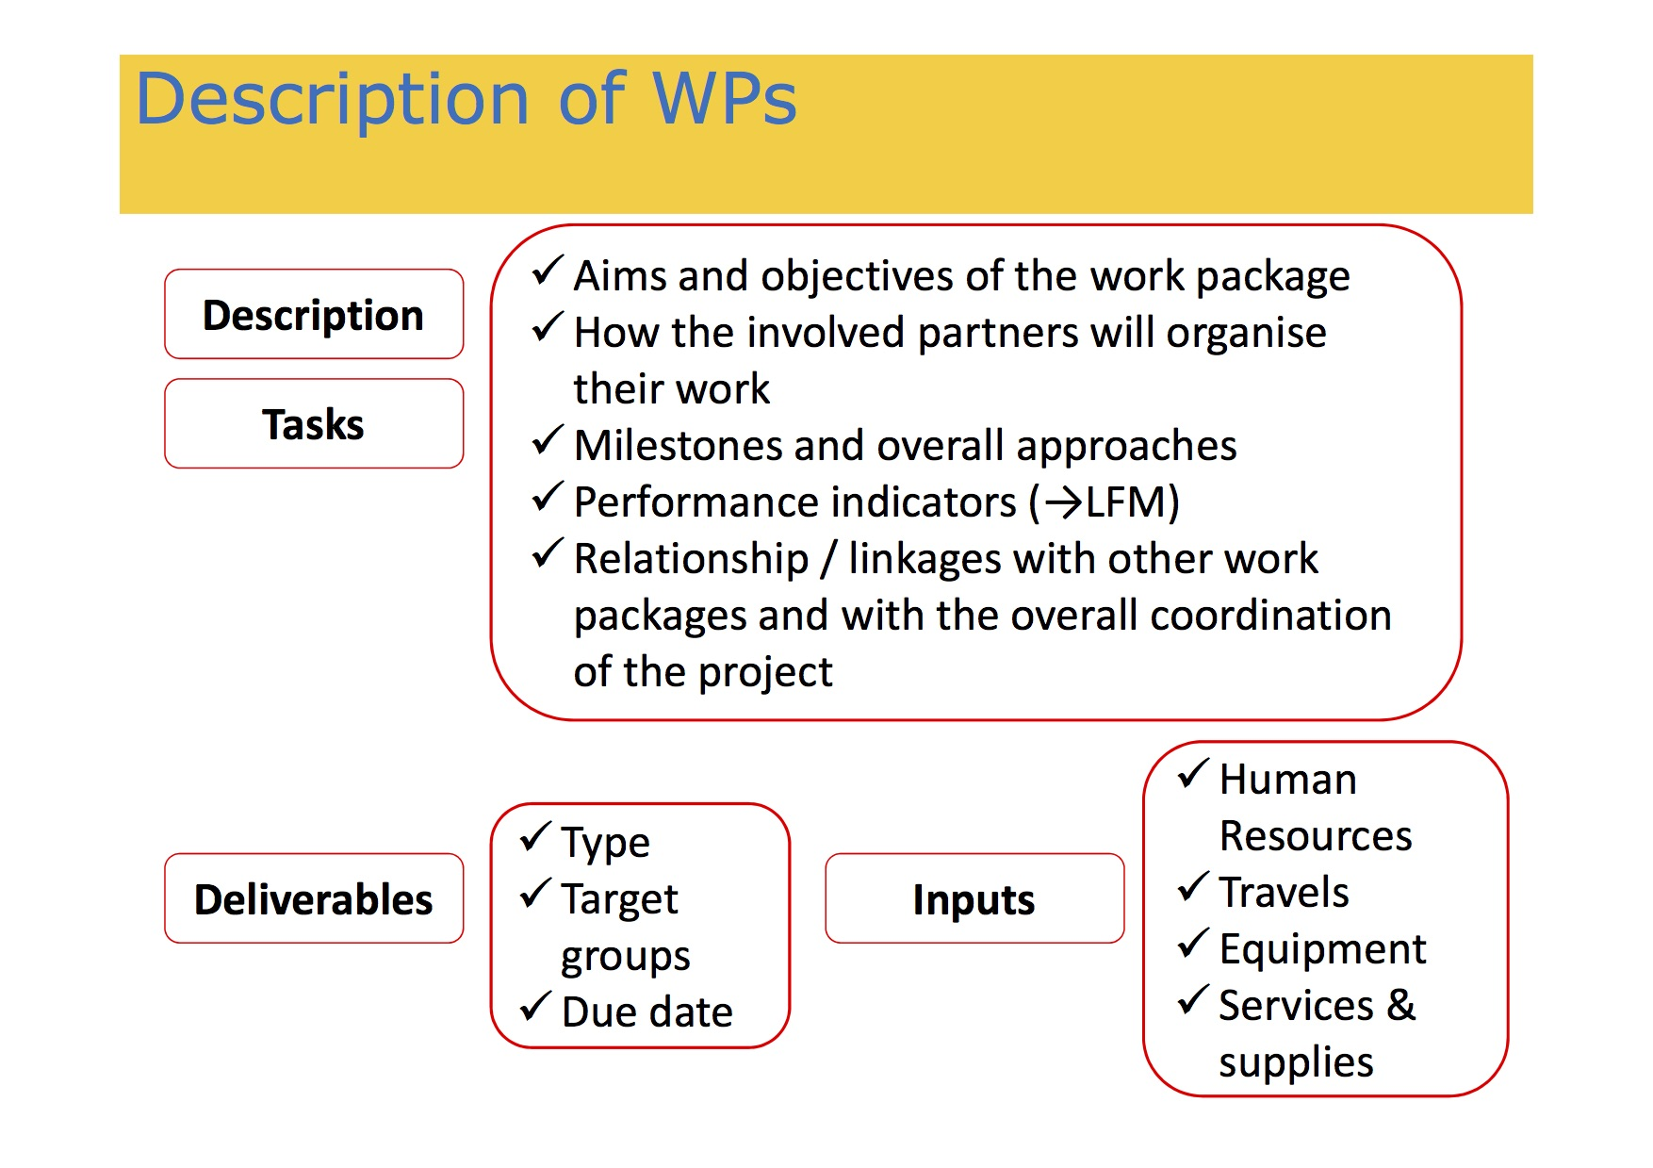
SOUPHANOUVONG UNIVERSITY

Slide 13
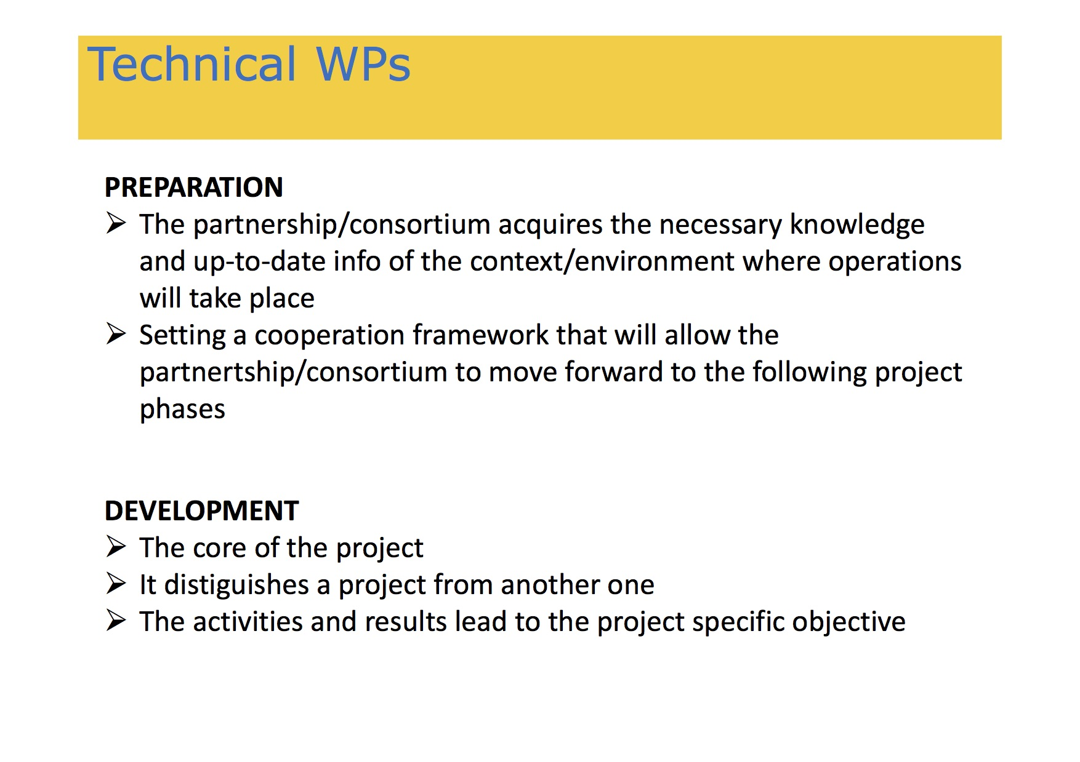
SOUPHANOUVONG UNIVERSITY

Slide 14
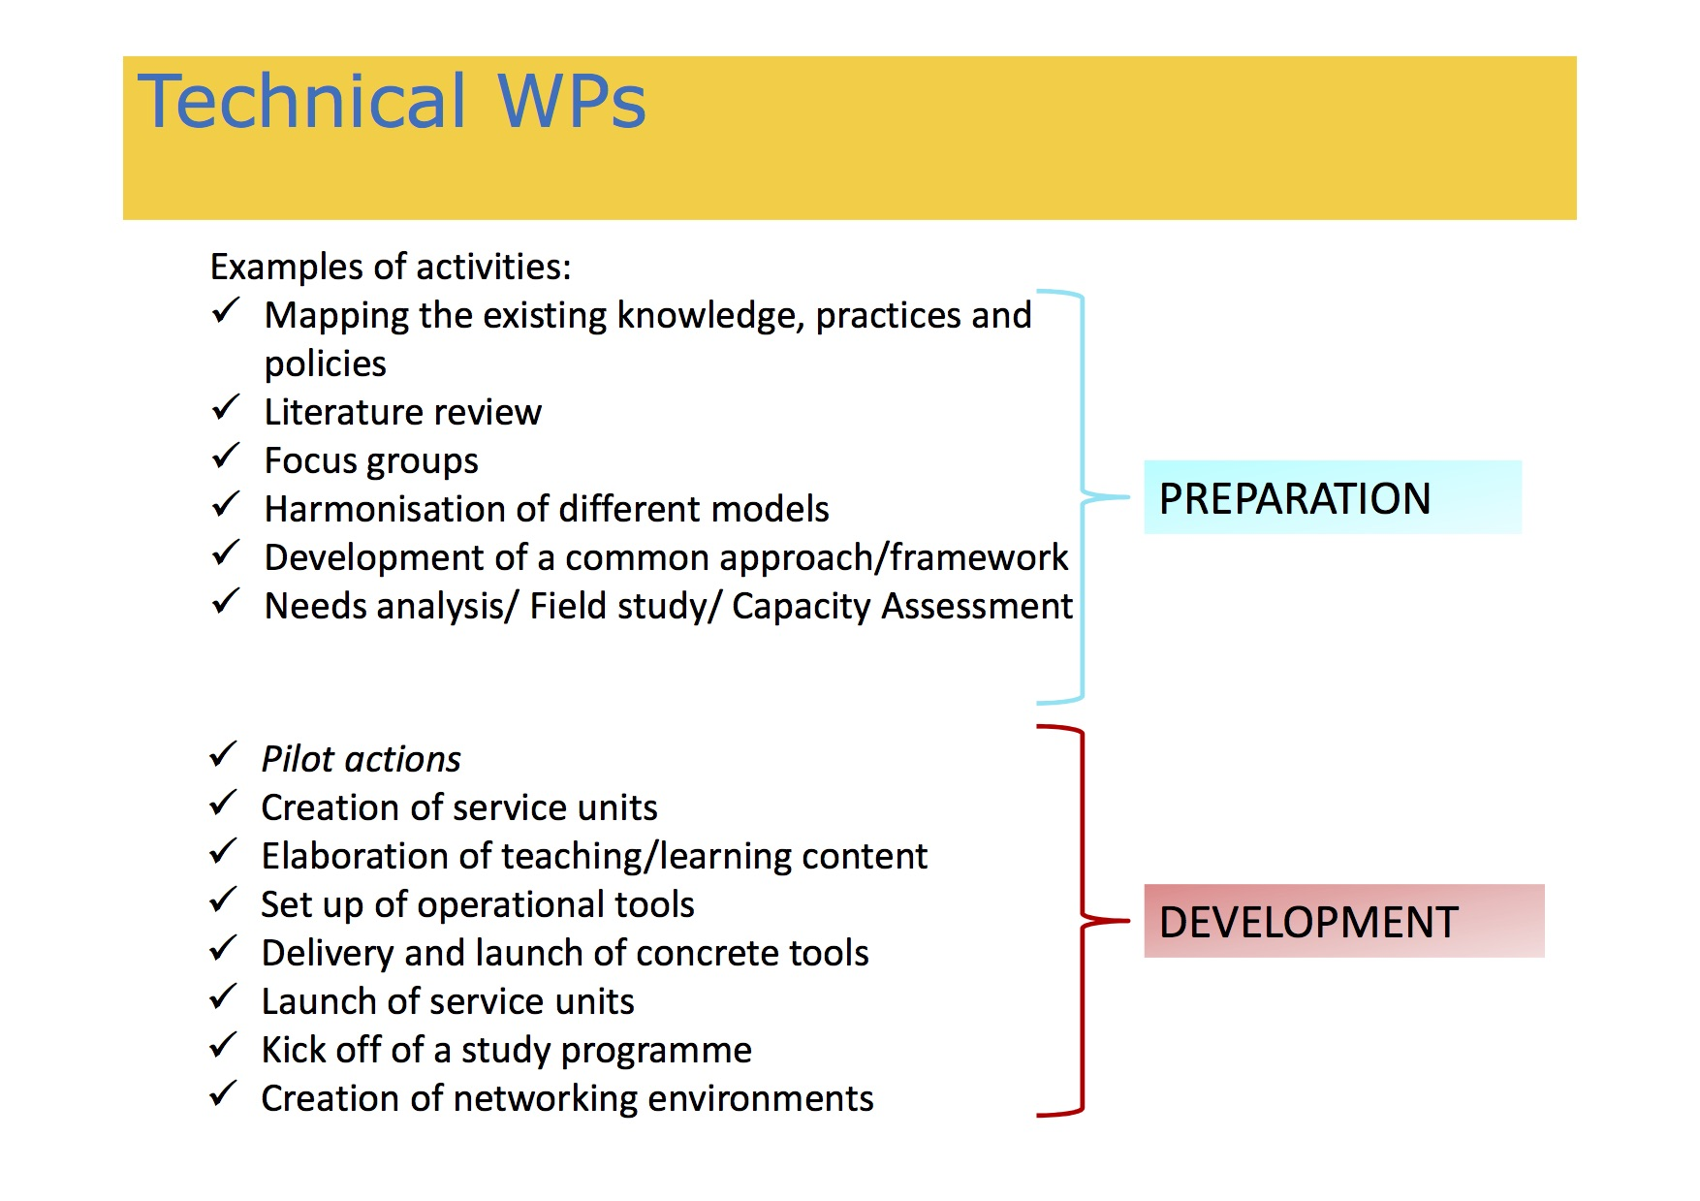
SOUPHANOUVONG UNIVERSITY

Slide 15
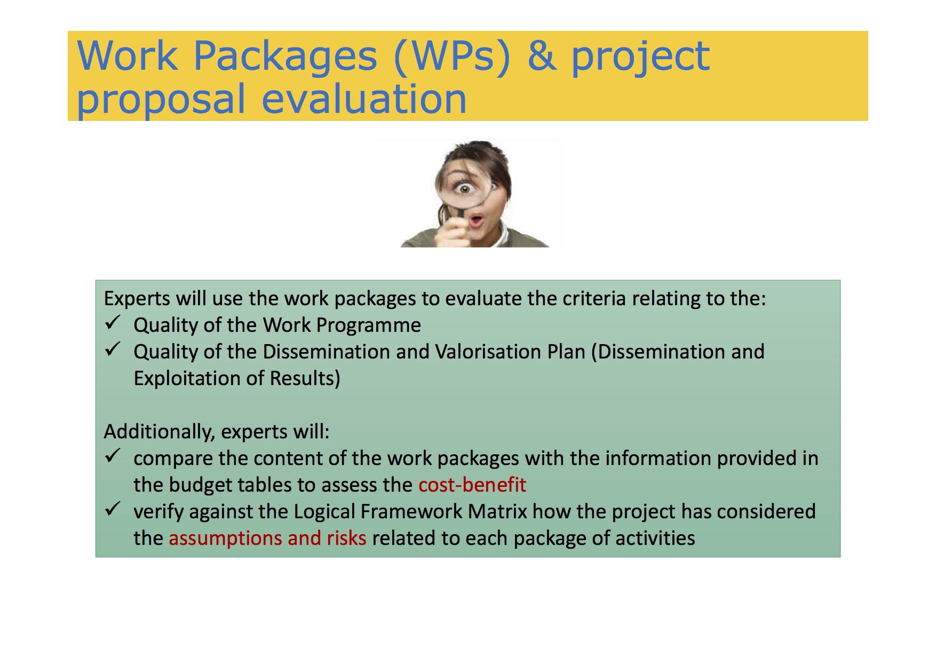
SOUPHANOUVONG UNIVERSITY

Slide 16
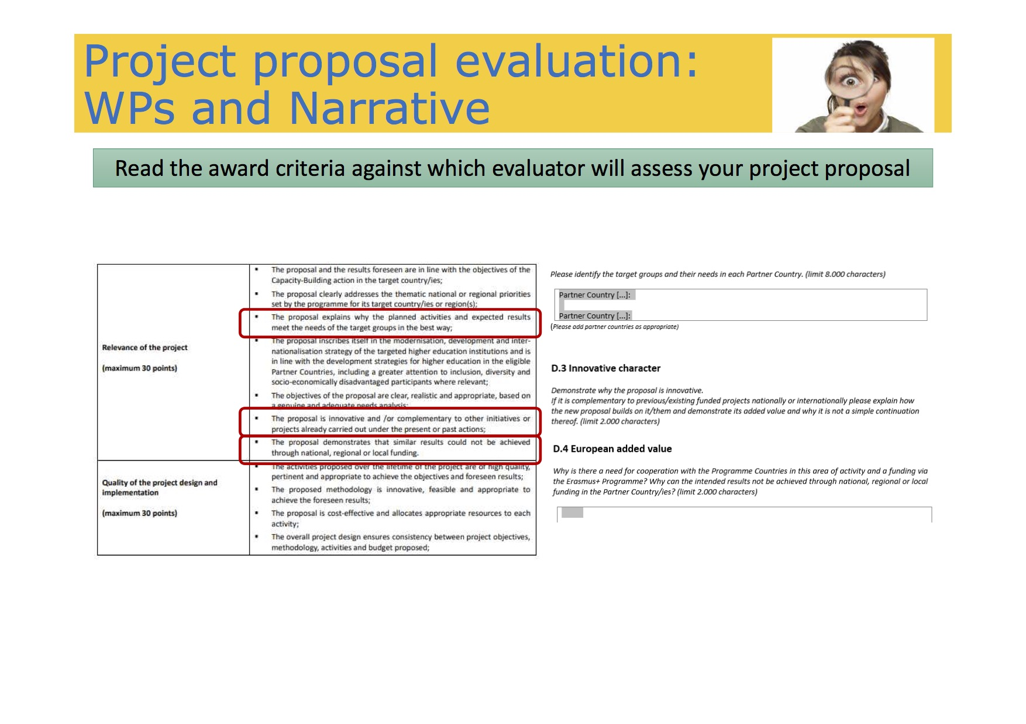
SOUPHANOUVONG UNIVERSITY

Slide 17
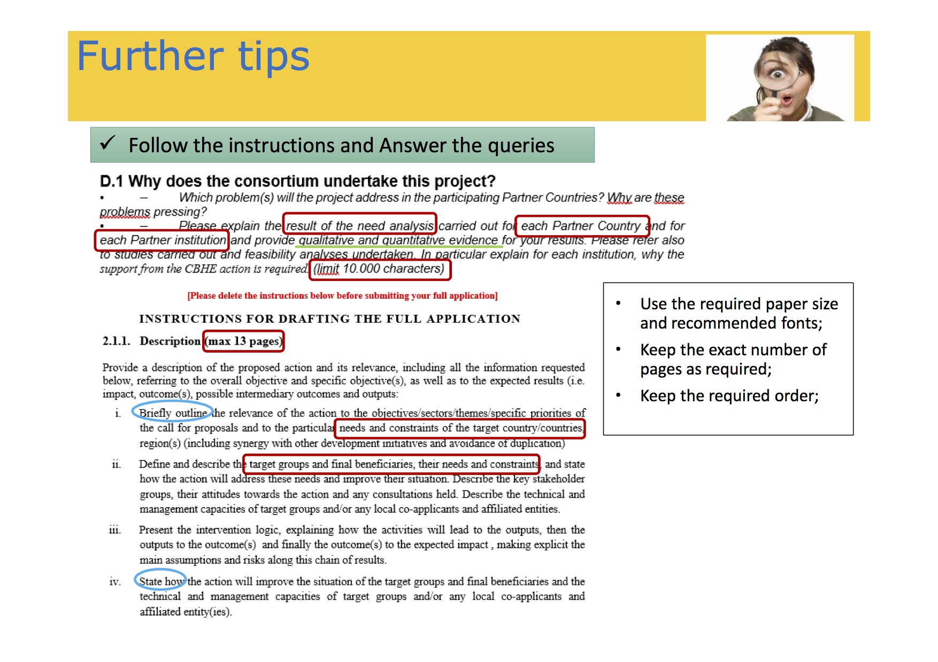
SOUPHANOUVONG UNIVERSITY

Slide 18
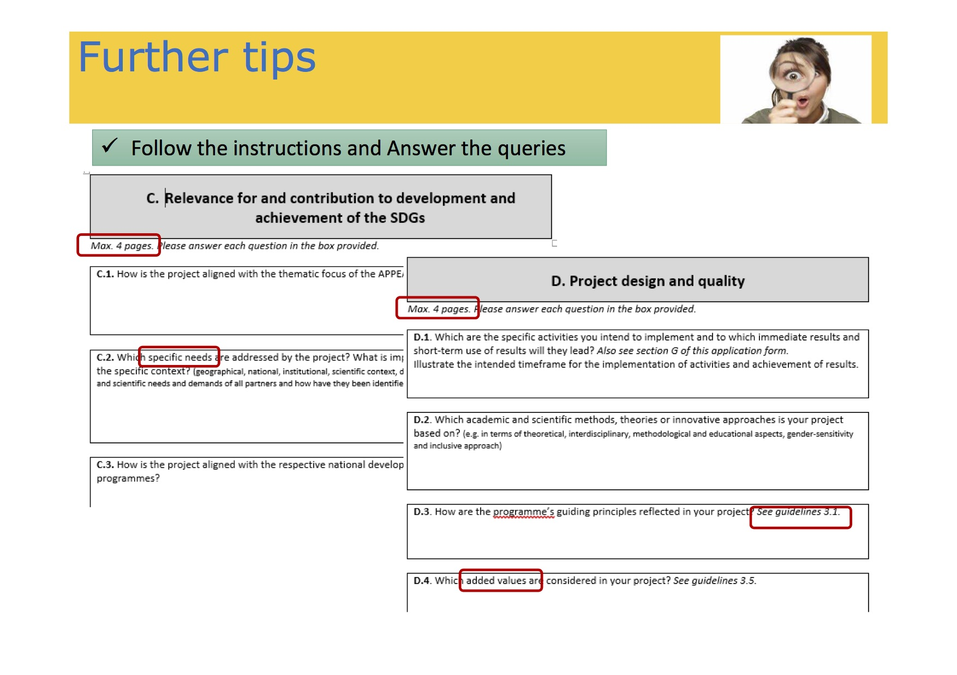
SOUPHANOUVONG UNIVERSITY

Slide 19
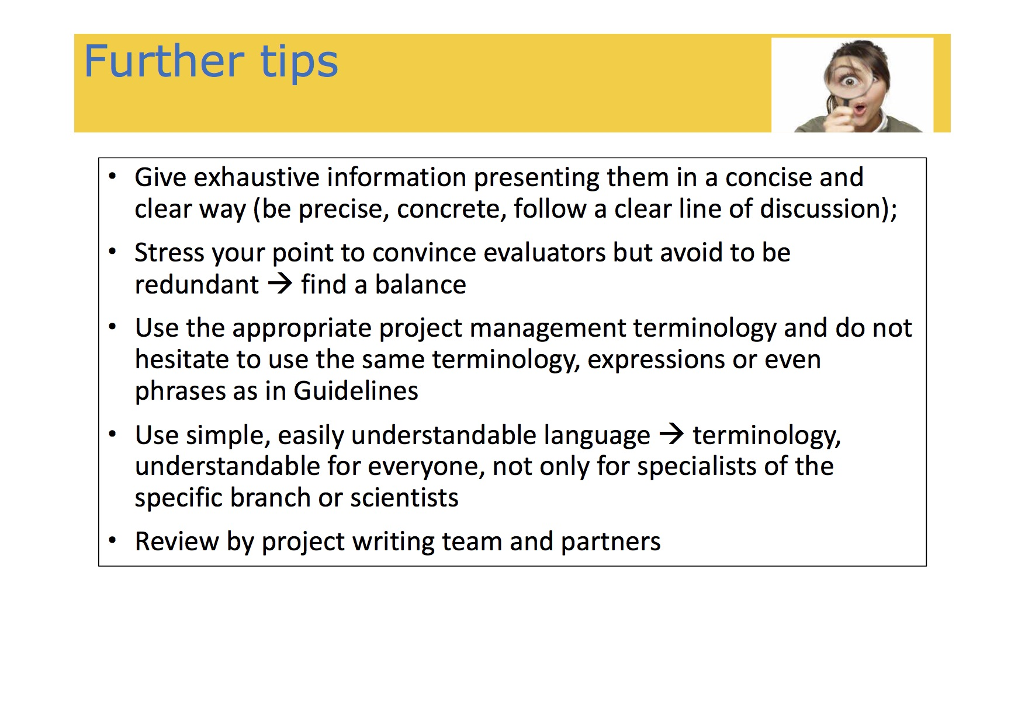
SOUPHANOUVONG UNIVERSITY

Slide 20
Souphanouvong University
Thank You for Your Attention
Any Questions?
SOUPHANOUVONG UNIVERSITY

